Slide 1
Lecture 14: Confidence Interval
Jibo He, Ph.D.
Associate Professor
Wichita State University
jibo.he@Wichita.edu

Slide 2
Shortcomings of Hypothesis Testing
Dichotomous decision making: null hypothesis significance tests that can result in one of only two possible decisions: either we reject H₀ or do not reject it H₀.
Hypothesis testing has some important limitations:
1) When we do not reject the null, we are not able to conclude anything. Thus, we may go to all the trouble of carrying out a statistical test and yet have little results of interest to report.

Slide 3
2) Further, the question of whether to reject/not reject the null hypothesis may be inappropriate in some research areas. In much social science research the goal is estimating the value of some parameter in the population where no particular value is specified in advance. In these situations, hypothesis testing is useless.
3) For example in pre-election polling, there is no pre-specified proportion of the population choosing a particular candidate. Rather, we ask samples of voters how they plan to vote to obtain an estimate of what this proportion really is in the population.

Slide 4
Estimates of Unknown Population Parameter
Estimates may take two forms:
Point estimates: estimations of a single value of a population parameter
Sample mean as a point estimate of population mean
Interval estimates: estimations of a range of values of a population parameter.
E.g., “I believe the mean age of all students at the university (μ) is somewhere between 23.4 years and 26.1 years”
What is a confidence interval for the mean?
It is an interval or range of values within which the true mean of the population is believed to be located.

Slide 5
How to construct a confidence interval?
Sample mean is the point estimate, and it is the starting point.
We build a cushion around sample mean to construct a confidence interval as follows
CI=Sample Mean ± Z×(?)
Let us review Z value for a second.
With a mean of 40 and a standard deviation of 5, what values would encompass 95% of the scores?
40 ± 5×1.96=[30.2, 49.8]

Slide 6
How to construct a confidence interval?
Frist, let us determine the Z value
Statisticians typically aim for either 95% or 99% confidence.
A Z-value of 1.96 is used for a 95% confidence interval
A Z-value of 2.58 is used for a 99% confidence interval
CI=Sample Mean ± Z×(?)

Slide 7
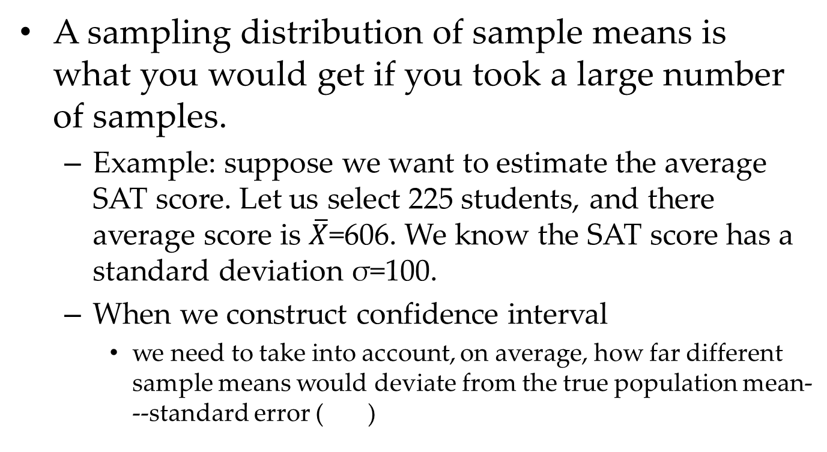
Logic behind confidence interval
A sampling distribution of sample means is what you would get if you took a large number of samples.
Example: suppose we want to estimate the average SAT score. Let us select 225 students, and there average score is $\overline{X}$=606. We know the SAT score has a standard deviation σ=100.
When we construct confidence interval
we need to take into account, on average, how far different sample means would deviate from the true population mean---standard error ( )
Notes:
samples---most of those sample means would be located toward the center of the distribution, but some of them would be located in the outer regions—the more extreme means

Slide 8
Confidence Intervals Meaning
CI=Sample Mean ± Z×(?)
? Is standard error unit
If we have a confidence interval formula
means that if we calculated CIs using the above equation, the population parameter μ would be inside the confidence limits γ percent of time, in the long run.
Let us compute the 95% confidence interval for the previous example
Notes:
606+/-1.96*100/sqrt(225)=[592.9,619.1]

Slide 9
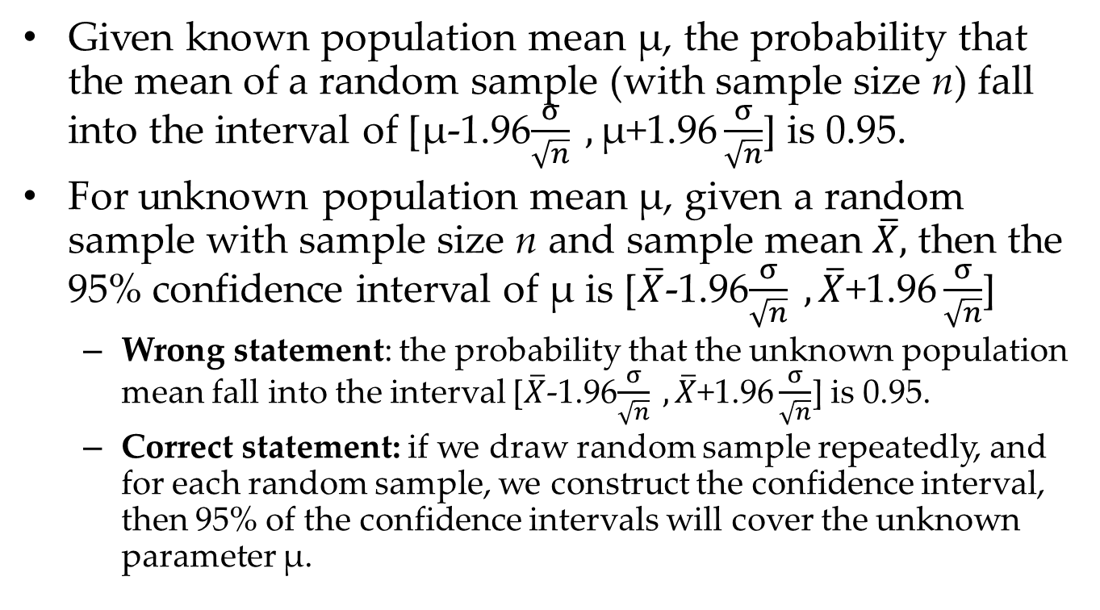
Interpretation of Confidence interval
Given known population mean μ, the probability that the mean of a random sample (with sample size n) fall into the interval of [μ-1.96$\frac{σ}{\sqrt{n}} ,\text{μ}\text{+}\text{1.96}\frac{σ}{\sqrt{n}}$] is 0.95.
For unknown population mean μ, given a random sample with sample size n and sample mean $\overline{X},$ then the 95% confidence interval of μ is [$\overline{X}$-1.96$\frac{σ}{\sqrt{n}} ,\overline{X}\text{+1.96}\frac{σ}{\sqrt{n}}$]
Wrong statement: the probability that the unknown population mean fall into the interval [$\overline{X}$-1.96$\frac{σ}{\sqrt{n}} ,\overline{X}\text{+1.96}\frac{σ}{\sqrt{n}}$] is 0.95.
Correct statement: if we draw random sample repeatedly, and for each random sample, we construct the confidence interval, then 95% of the confidence intervals will cover the unknown parameter μ.

Slide 10
Illustration of Confidence Interval: 95%
The width of each confidence interval is the same
Notes:
We would always be wrapping the same amount around our sample mean

Slide 11
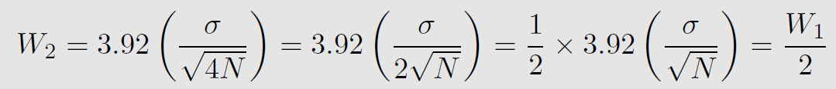
Factors that will affect the width of the confidence interval
Level of confidence
Sample size
What happens when we increase the sample size, N:
The width of a 95% confidence interval
Anything being equal, if we multiply the sample size by 4, what happened?

Slide 12
Illustration of Confidence Interval: 99%

Slide 13
Illustration of Confidence Interval: 80%

Slide 14
More confidence→ Need wider intervals
Comparing a 95% to a 99% CI for the mean
This idea makes sense
More confidence → larger area to cover
If we want to be more sure, we need to account for more things.

Slide 15
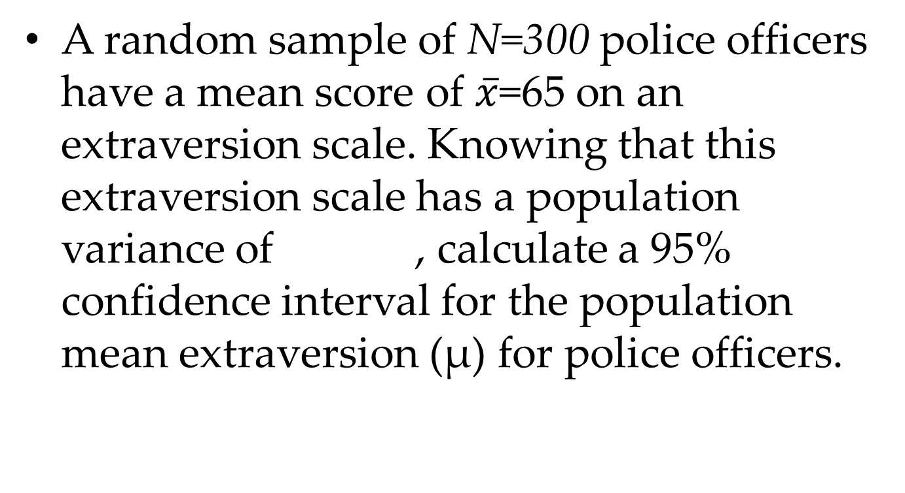
Practice with Confidence Intervals
A random sample of N=300 police officers have a mean score of $\overline{x}$=65 on an extraversion scale. Knowing that this extraversion scale has a population variance of , calculate a 95% confidence interval for the population mean extraversion (µ) for police officers.

Slide 16
Practice with Confidence Intervals
A random sample of N=300 police officers have a mean score of $\overline{x}$=65 on an extraversion scale. Knowing that this extraversion scale has a population variance of , calculate a 95% confidence interval for the population mean extraversion (µ) for police officers.

Slide 17
Confidence Interval Summary
Remember
The chance that a parameter is within a set of observed limits is not equal to the confidence interval—it is equal to 0 or 1.
γ corresponds to how often one is willing to be correct in this assumption (the assumption that the unknown population parameter is in the interval)
People usually set it to be γ = .95
Corresponds to α=.05, which we will talk about soon.

Slide 18
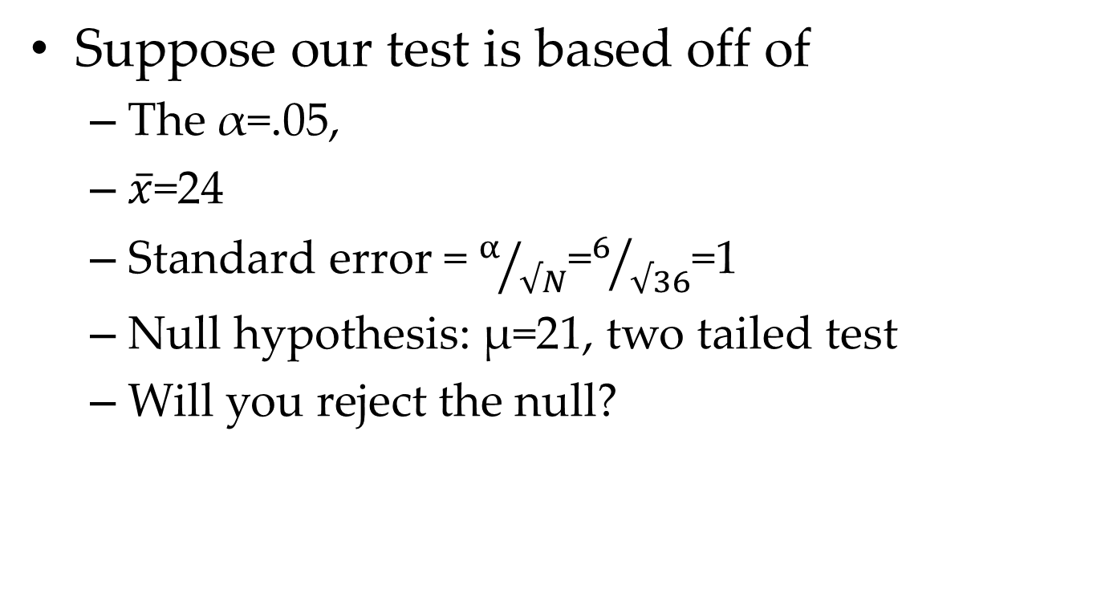
NHST and Confidence Interval
Suppose our test is based off of
The α=.05,
$\overline{x}$=24
Standard error = $α/{√N}$=$6/{√36}$=1
Null hypothesis: μ=21, two tailed test
Will you reject the null?

Slide 19
NHST and Confidence Interval
Using a two-tailed test with α=.05, we found that
We rejected the null hypothesis that μ=21
Using a 95% confidence interval, we found that µ=21 was not a plausible parameter value
So based on above
a two tailed test using α=.05 , and
a confidence interval with level of 95%
We reached the same decision. Coincidence?

Slide 20
NHST and Confidence Interval
If you were to do the algebra, you would conclude
Let γ =1-α
Make the hypothesis test two-tailed
Then testing the null hypothesis is equivalent to determining whether the null value is within the confidence limits.
This means that
If the null hypothesis is rejected, then the null value will not be in the confidence limits.
If the null hypothesis is not rejected, then the null value will be in the confidence limits.

Slide 21
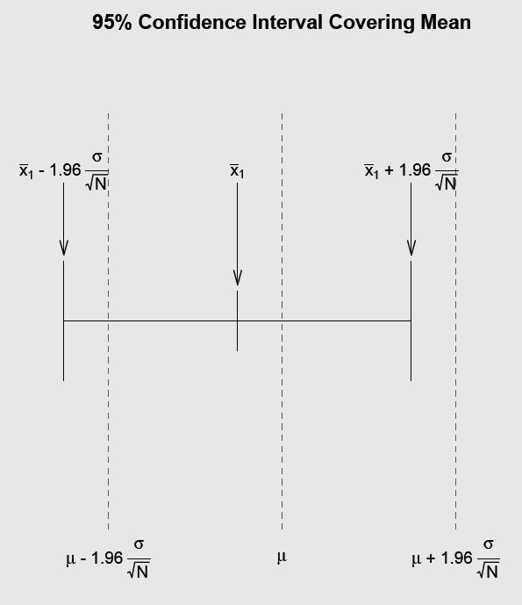
Need more visualization?

Slide 22
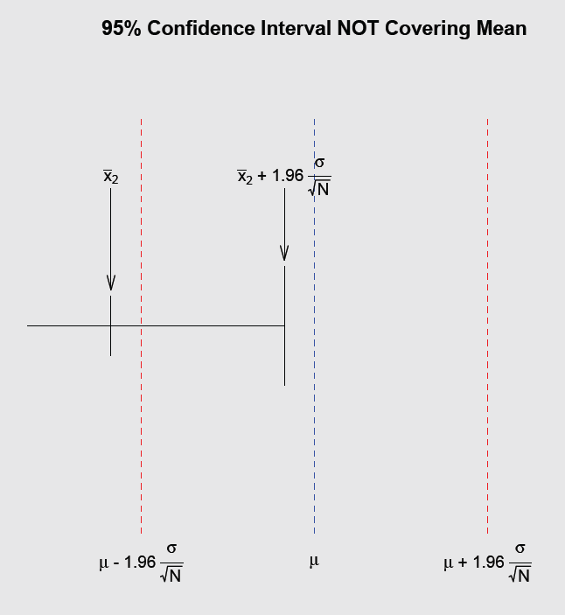
Need more visualization?

Slide 23
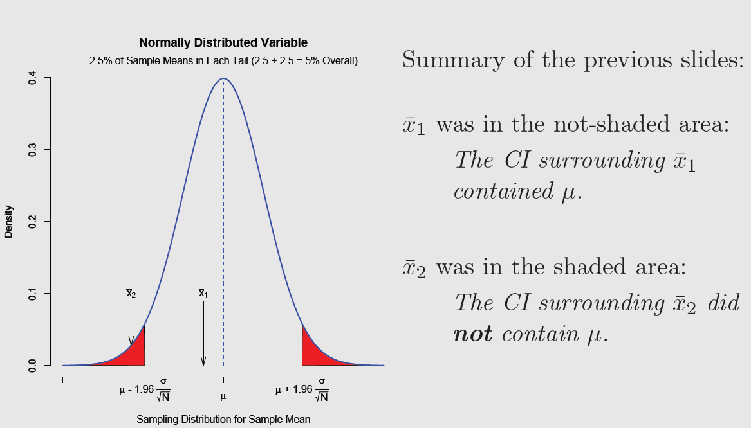

Slide 24
Confidence Intervals for Population mean
(1-α)% Confidence Interval for μ when σ is unknown
As in hypothesis testing, we replace with and Z_{crit.} with t_{crit.}:
This will result in a somewhat wider confidence interval.

Slide 25
Example 2: The math SATs is administered to a random sample of 36 college freshmen at Spartan University and the sample mean is found to be 518. We want a 95% confidence interval, but we do not know the population standard deviation. Instead, we compute the sample estimate of the standard deviation and obtain a value of 110.

Slide 26
Example 2: The math SATs is administered to a random sample of 36 college freshmen at Spartan University and the sample mean is found to be 518. We want a 95% confidence interval, but we do not know the population standard deviation. Instead, we compute the sample estimate of the standard deviation and obtain a value of 110.
Step 1: First, we compute the value of

Slide 27
Step 2: Next, we find the appropriate value of t_{crit}. In this case, we want to construct a 95% confidence interval, so α = .05. We are looking for a two-tailed t_{crit.}, so we look in our t table for an area of .025 in each tail for df = n – 1 = 36 – 1 = 35. We find t_{crit.} = ±2.03.
Step 3: Substituting these values, along with , into our confidence interval formula, we have:

